Slide 1



Psychometric Session Objectives
Understand key statistics of testing
Understand how to set flags and review flagged test items
Understand how key validation fits into the exam development cycle
Psychometric Presentation

Slide 2
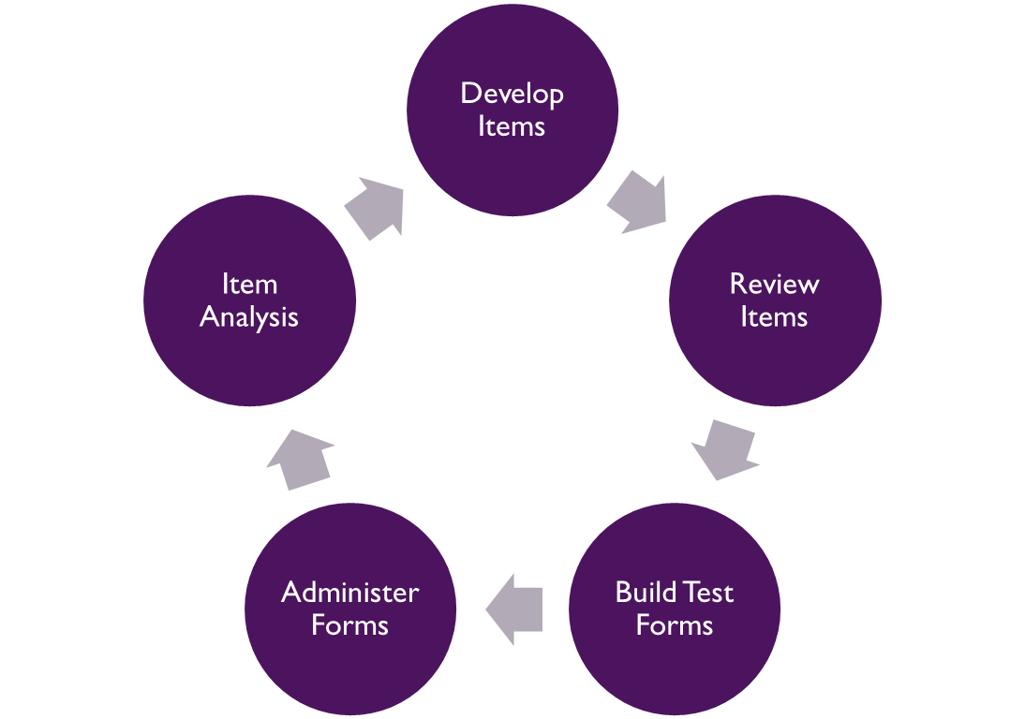


A typical exam cycle

Slide 3

Item Analysis
Item analysis is a statistical analysis of the response data gathered from an assessment.
This type of analysis provides clues about which items are working well and which items may need a second look.
Today, we will focus on just a few item-evaluation metrics.

Slide 4
Item Statistics
p-value - the proportion of people who answer an item correctly
Distractor proportions - the proportion of people selecting each incorrect option
Point-biserial correlation - the relationship between performance of a specific item and the performance of the total exam
We use these three measures in combination to help find flawed items

Slide 5

P-value (P)
P is the proportion of examinees who answer a question correctly.
What is a good P or what is a bad P?
  Depends on context
  Depends on the exam's intent (validity argument?)

Slide 6

Point Biserial Correlation
What is a good point biserial correlation?
  It is positive
  It is further away from zero
  Could be context based
Point biserial correlation is usually impacted by item difficulty:
  Very difficult and very easy items tend to discriminate poorly.
  Items whose difficulty are around the average performance tend to discriminate better.

Slide 7
Item Statistics
What might constitute evidence that an item is functioning properly?
  p-value is greater than chance: the proportion of people answering correctly should be greater than chance.
  The key is selected most often.
  positive point-biserial correlation: the probability of an examinee getting the question correct increases with a test-taker’s ability.
  The key should have the highest, positive point biserial correlation

Slide 8

Item Statistics
What might constitute evidence that an item is not functioning properly?
  P-value is below chance.
  Negative, or near-zero, point-biserial correlation (low performers are more or as likely to answer correctly).
  One or more answer option is selected at a high rate.
    Are we giving away the answer?
    Is the item mis-keyed?
    Do we have bad distractors?

Slide 9
A Short Quiz
An item has a p-value of .75 and a point-biserial of 0.20
An item has a point-biserial near zero and a p-value of 0.15
An item has a p-value of 0.95
  Is this a good item?
  How do you know?

Slide 10
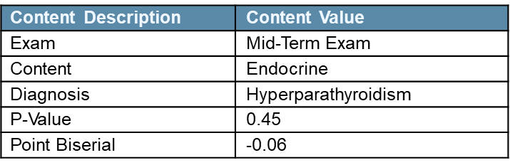
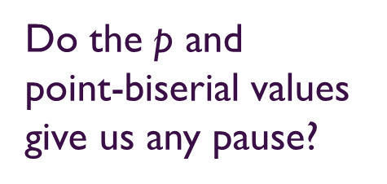
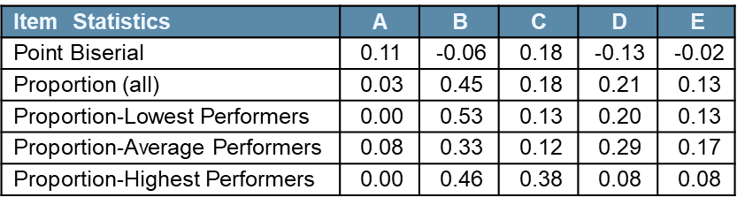
Example of Item Analysis Output

Slide 11
Example of Item Analysis Output
Content Description | Content Value
Exam | Mid-Term Exam
Content | Endocrine
Diagnosis | Hyperparathyroidism
P-Value | 0.63
Point Biserial | 0.29
How about these
p and point-biserial
values?
What is the correct
answer?
Item Statistics | A | B | C | D | E
Point Biserial | 0.29 | -0.20 | -0.05 | -0.15 | -0.15
Proportion (all) | 0.63 | 0.10 | 0.18 | 0.05 | 0.04
Proportion-Lowest Performers | 0.44 | 0.19 | 0.21 | 0.08 | 0.08
Proportion-Average Performers | 0.65 | 0.09 | 0.20 | 0.04 | 0.03
Proportion-Highest Performers | 0.84 | 0.03 | 0.12 | 0.01 | 0.01
This kind of stair-
stepping is what we
like to see.
The highest performers give us
a clue.

Slide 12
Conducting an Analysis
An item analysis can be complicated and typically requires special software.
However, for small-scale analyses, most item statistics can be computed in an EXCEL spreadsheet using basic functions:
  AVERAGE
  CORREL
  COUNTIF
  SUM

Slide 13
Conducting Item Analysis
When conducting large scale item analysis, the following software/programs are typically used.
  Winsteps (for Rasch and 1PL)
  BILOG-MG
  MULTILOG
  R (with tons of psychometric packages)
  SAS
  SPSS

Slide 14
Data Characteristics Considerations
The following are some data characteristics to consider to ensure valid interpretation of your results:
Variability: Too little or too much variability yields less reliable estimates.
Sample size: Larger sample size yields more reliable estimates.
Outliers: Outliers negatively impacts reliability of estimates.
Unambiguous Answers Key: Only one clearly correct answer yields more reliable estimates.

Slide 15
Flagging Items
The purpose of the item analysis is to identify items that need additional content review.
Establishing appropriate statistical criteria for reviewing items is essential.
The next activity will focus on how you might go about flagging items for review.

Slide 16

Flagging Items
Different flags may make sense in different scenarios.
Typical reasons for flagging an item may include:
  Too easy (Is it intended or are we giving the item away with a clue in the stem?)
  Too hard (Is this mis-keyed, not appropriate for the population, or have the standards of care changed?)
  Poor/Negative discrimination (Is this mis-keyed? Is there another answer that could be correct?)

Slide 17

Flagging Items
Flags are just an indication that something could be wrong.
  Item statistics are just a way to start the process.
  After flagging an item, a content review should be conducted.
All flags are not equally critical.
It is very important to take your population into account when judging your statistics.

Slide 18

What is Key Validation (KV)?
Key validation is the process we use to review items that have been flagged during item analysis.
The process requires at least one content expert, but ideally more, to review items.
Having a diverse group of subject matter experts in terms of experience, practice location, etc. lends its advantages to the process.

Slide 19

Reviewing Flagged Items
A committee of subject-matter experts reviews each item focusing on the content while keeping in mind:
  Certain statistical clues can be used to help point to potential problems.
  Items will be flagged even though there is no content-based rationale—we should not rely solely on the statistics for item removal.
Remember the purpose of the exercise is to identify flawed items, not to critique the item writer, or rewrite the items during key validation.

Slide 20
Reviewing Flagged Items
Items should not be removed solely based on their difficulty level.
  Some content areas can mostly be assessed with easy items and some others with difficult items.
  A range of difficult items are needed to separate examinees into performance groups.
Sometimes, items deemed flawed on a particular exam (e.g., PANCE) could be appropriate for a more specialized exam (e.g., CAQs).

Slide 21
Making Decisions
Keep
Item is current and clinically relevant
No flaws are identified in the review
Rewrite
Item has flaws
Assesses appropriate content
Can be salvaged with minimal changes
Rekey
Item has incorrect answer key
A different option is the correct key
Delete
Item is not current or clinically relevant
Major effort to correct identified flaws

Slide 22
Example of Item Review
A 48-year-old woman comes to the office because she awoke this morning with pain and redness in her right eye that has worsened over the past eight hours. She says she is now having difficulty opening the eye because light causes pain. Medical history includes rheumatoid arthritis. Current medications include etanercept and methotrexate. Vital signs are within normal limits. Physical examination shows pronounced injection of the right eye with a nodular appearance of the sclera. Photophobia is noted on funduscopic examination of the eye. The right pupil is noticeably smaller than the left, and the right cornea appears slightly cloudy. Which of the following is the most likely cause of this patient's symptoms?
Item Statistics | A | B | C | D | E
Point Biserial | -0.03 | -0.06 | 0.09 | -0.12 | 0.07
Proportion (all) | 0.55 | 0.02 | 0.10 | 0.10 | 0.23
Proportion-Lowest Performers | 0.55 | 0.03 | 0.08 | 0.12 | 0.22
Proportion-Average Performers | 0.57 | 0.01 | 0.09 | 0.13 | 0.20
Proportion-Highest Performers | 0.52 | 0.01 | 0.15 | 0.05 | 0.28
A. Acute narrow-angle glaucoma
B. Corneal abrasion
C. Iritis
D. Optic neuritis
E. Scleritis

Slide 23
Example of Item Review
A 15-year-old girl has had diarrhea since returning from a camping trip 12 days ago. She is afebrile and appears well despite mild diarrhea. Results of stool studies are negative for enteric pathogens, and three stool specimens are negative for ova and parasites. Which of the following is the most likely diagnosis?
Amebiasis
Giardiasis
Irritable bowel syndrome
Salmonellosis
Toxoplasmosis
Item Statistics | A | B | C | D | E
Point Biserial | 0.02 | -0.01 | 0.03 | -0.05 | -0.02
Proportion (all) | 0.06 | 0.57 | 0.27 | 0.08 | 0.01
Proportion-Lowest Performers | 0.07 | 0.55 | 0.28 | 0.09 | 0.01
Proportion-Average Performers | 0.05 | 0.60 | 0.26 | 0.08 | 0.01
Proportion-Highest Performers | 0.07 | 0.58 | 0.29 | 0.05 | 0.01

Slide 24
Example of Item Review
A 20-year-old woman comes to the clinic because she has had episodes of diarrhea, intermittent pain in the right side of her lower abdomen, and flushing during the past two years. Physical examination shows no abnormalities. Laboratory studies show elevated 24-hour urinary 5-hydroxyindoleacetic acid (5-HIAA) level, which is consistent with carcinoid tumor. Which of the following is the most likely location of carcinoid tumor in this patient?
A. Appendix
B. Colon
C. Rectum
D. Small intestine
E. Stomach
Item Statistics | A | B | C | D | E
Point Biserial | 0.03 | -0.07 | -0.01 | 0.05 | -0.02
Proportion (all) | 0.37 | 0.31 | 0.00 | 0.26 | 0.06
Proportion-Lowest Performers | 0.36 | 0.39 | 0.00 | 0.24 | 0.06
Proportion-Average Performers | 0.34 | 0.33 | 0.00 | 0.26 | 0.06
Proportion-Highest Performers | 0.41 | 0.27 | 0.00 | 0.27 | 0.05

Slide 25
Example of Item Review
A 23-year-old woman is brought to the emergency department because she has multiple injuries and evidence of hypovolemic shock after she was involved in a motor vehicle collision. Initial administration of which of the following fluids is most appropriate for resuscitation of this patient?
A. 5% Albumin
B. 5% Dextrose in water
C. Lactated Ringer solution
D. Packed red blood cells
E. Whole blood
Item Statistics | A | B | C | D | E
Point Biserial | 0.01 | -0.12 | -0.0017 | 0.06 | -0.0077
Proportion (all) | 0.01 | 0.02 | 0.70 | 0.13 | 0.14
Proportion-Lowest Performers | 0.00 | 0.04 | 0.69 | 0.11 | 0.15
Proportion-Average Performers | 0.01 | 0.01 | 0.73 | 0.13 | 0.12
Proportion-Highest Performers | 0.01 | 0.01 | 0.68 | 0.16 | 0.14

Slide 26
Example of Item Review
A 72-year-old man comes to the office four hours after he had sudden onset of tinnitus and hearing loss in his right ear. Medical history includes coronary artery disease and peripheral vascular disease. The patient takes one 81-mg aspirin tablet daily. On physical examination of the right ear, the external auditory canal is clear of lesions, and the tympanic membrane is intact and mobile with insufflation. No nystagmus is noted. Weber and Rinne tests show sensorineural hearing loss on the right. Which of the following diagnostic studies is most appropriate to confirm a diagnosis?
A. Analysis of cerebrospinal fluid
B. Cerebral angiography
C. Contrast-enhanced CT scan of the head
D. Electroencephalography
E. Toxicology screening
Item Statistics | A | B | C | D | E
Point Biserial | -0.01 | 0.01 | -0.06 | -0.05 | 0.08
Proportion (all) | 0.00 | 0.24 | 0.51 | 0.02 | 0.23
Proportion-Lowest Performers | 0.00 | 0.23 | 0.57 | 0.02 | 0.18
Proportion-Average Performers | 0.00 | 0.25 | 0.49 | 0.02 | 0.24
Proportion-Highest Performers | 0.00 | 0.22 | 0.48 | 0.01 | 0.28

Slide 27
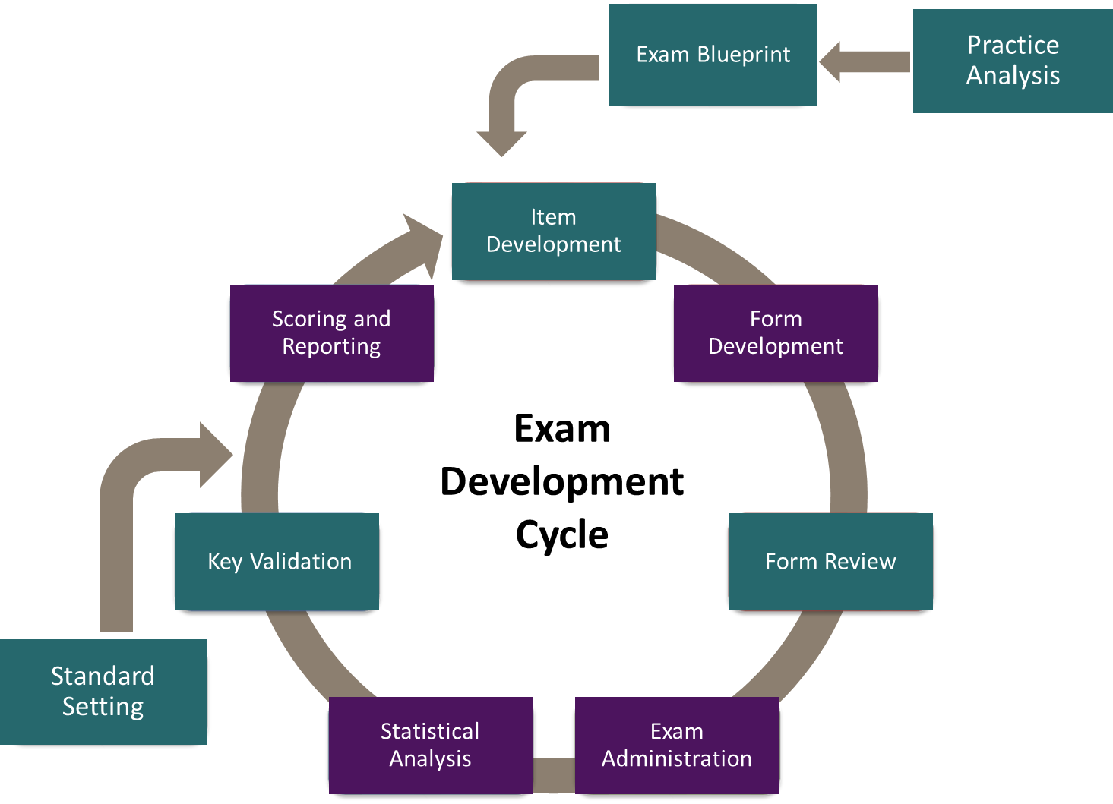
A typical exam cycle

Slide 28

Key Validation in Exam Development Cycle
Key validation provides an additional opportunity to identify flawed items and make appropriate decisions:
  Items written over a period with outdated content can be modified.
  Items with inappropriate content can be removed from scoring in the current and/or future administration.
  It provides some bases of fairness for examinees by ensuring that only construct-relevant content is covered with appropriate level of difficulty.
Not all flagged items are truly flawed, hence KV exemplifies the bridge between statistics and content expertise in developing high quality assessments.

