Slide 1
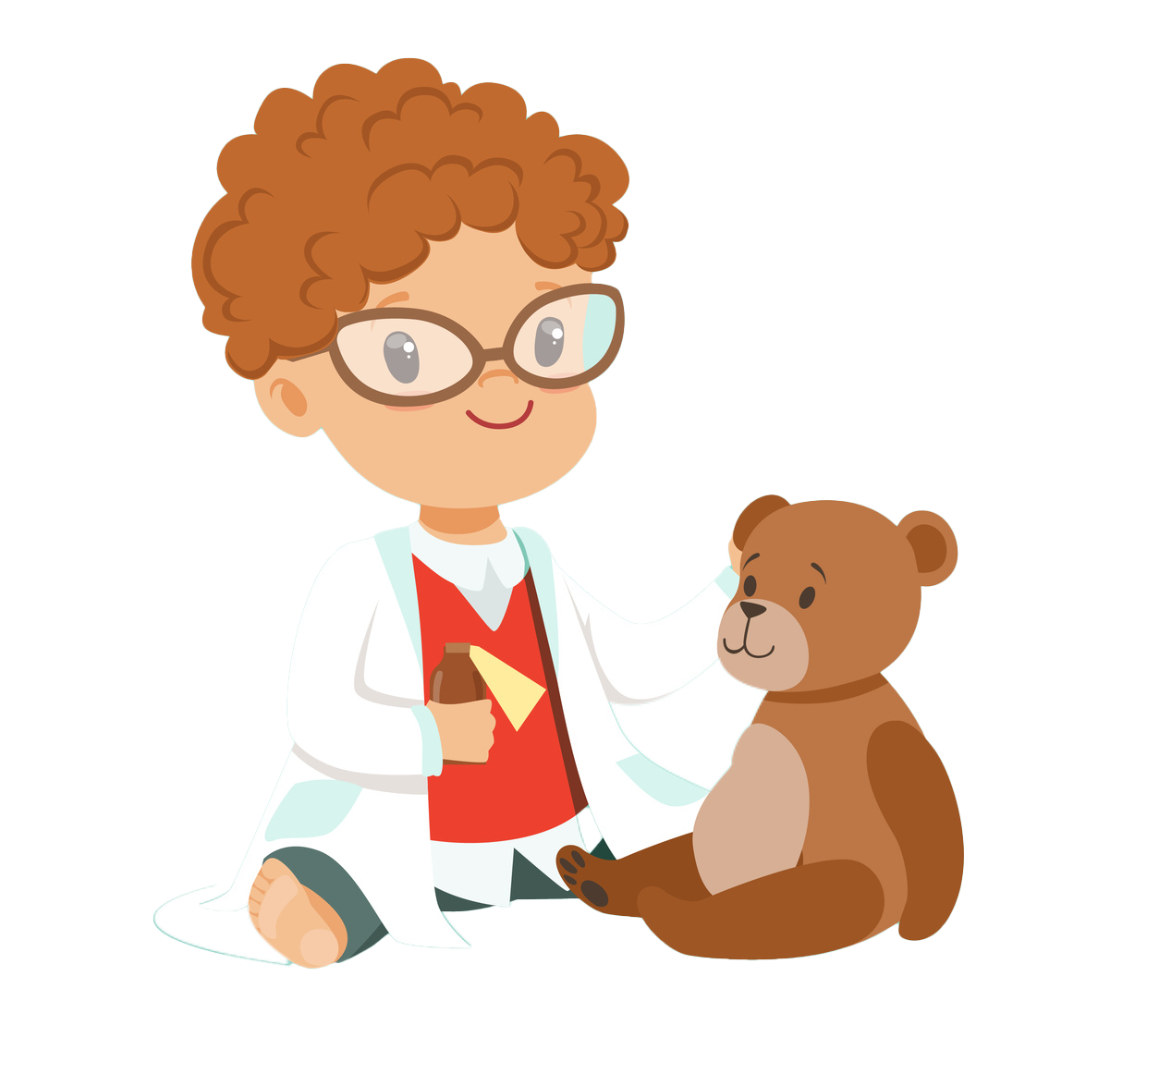
I Can Be a Physician Assistant/Associate (PA)!

Slide 2
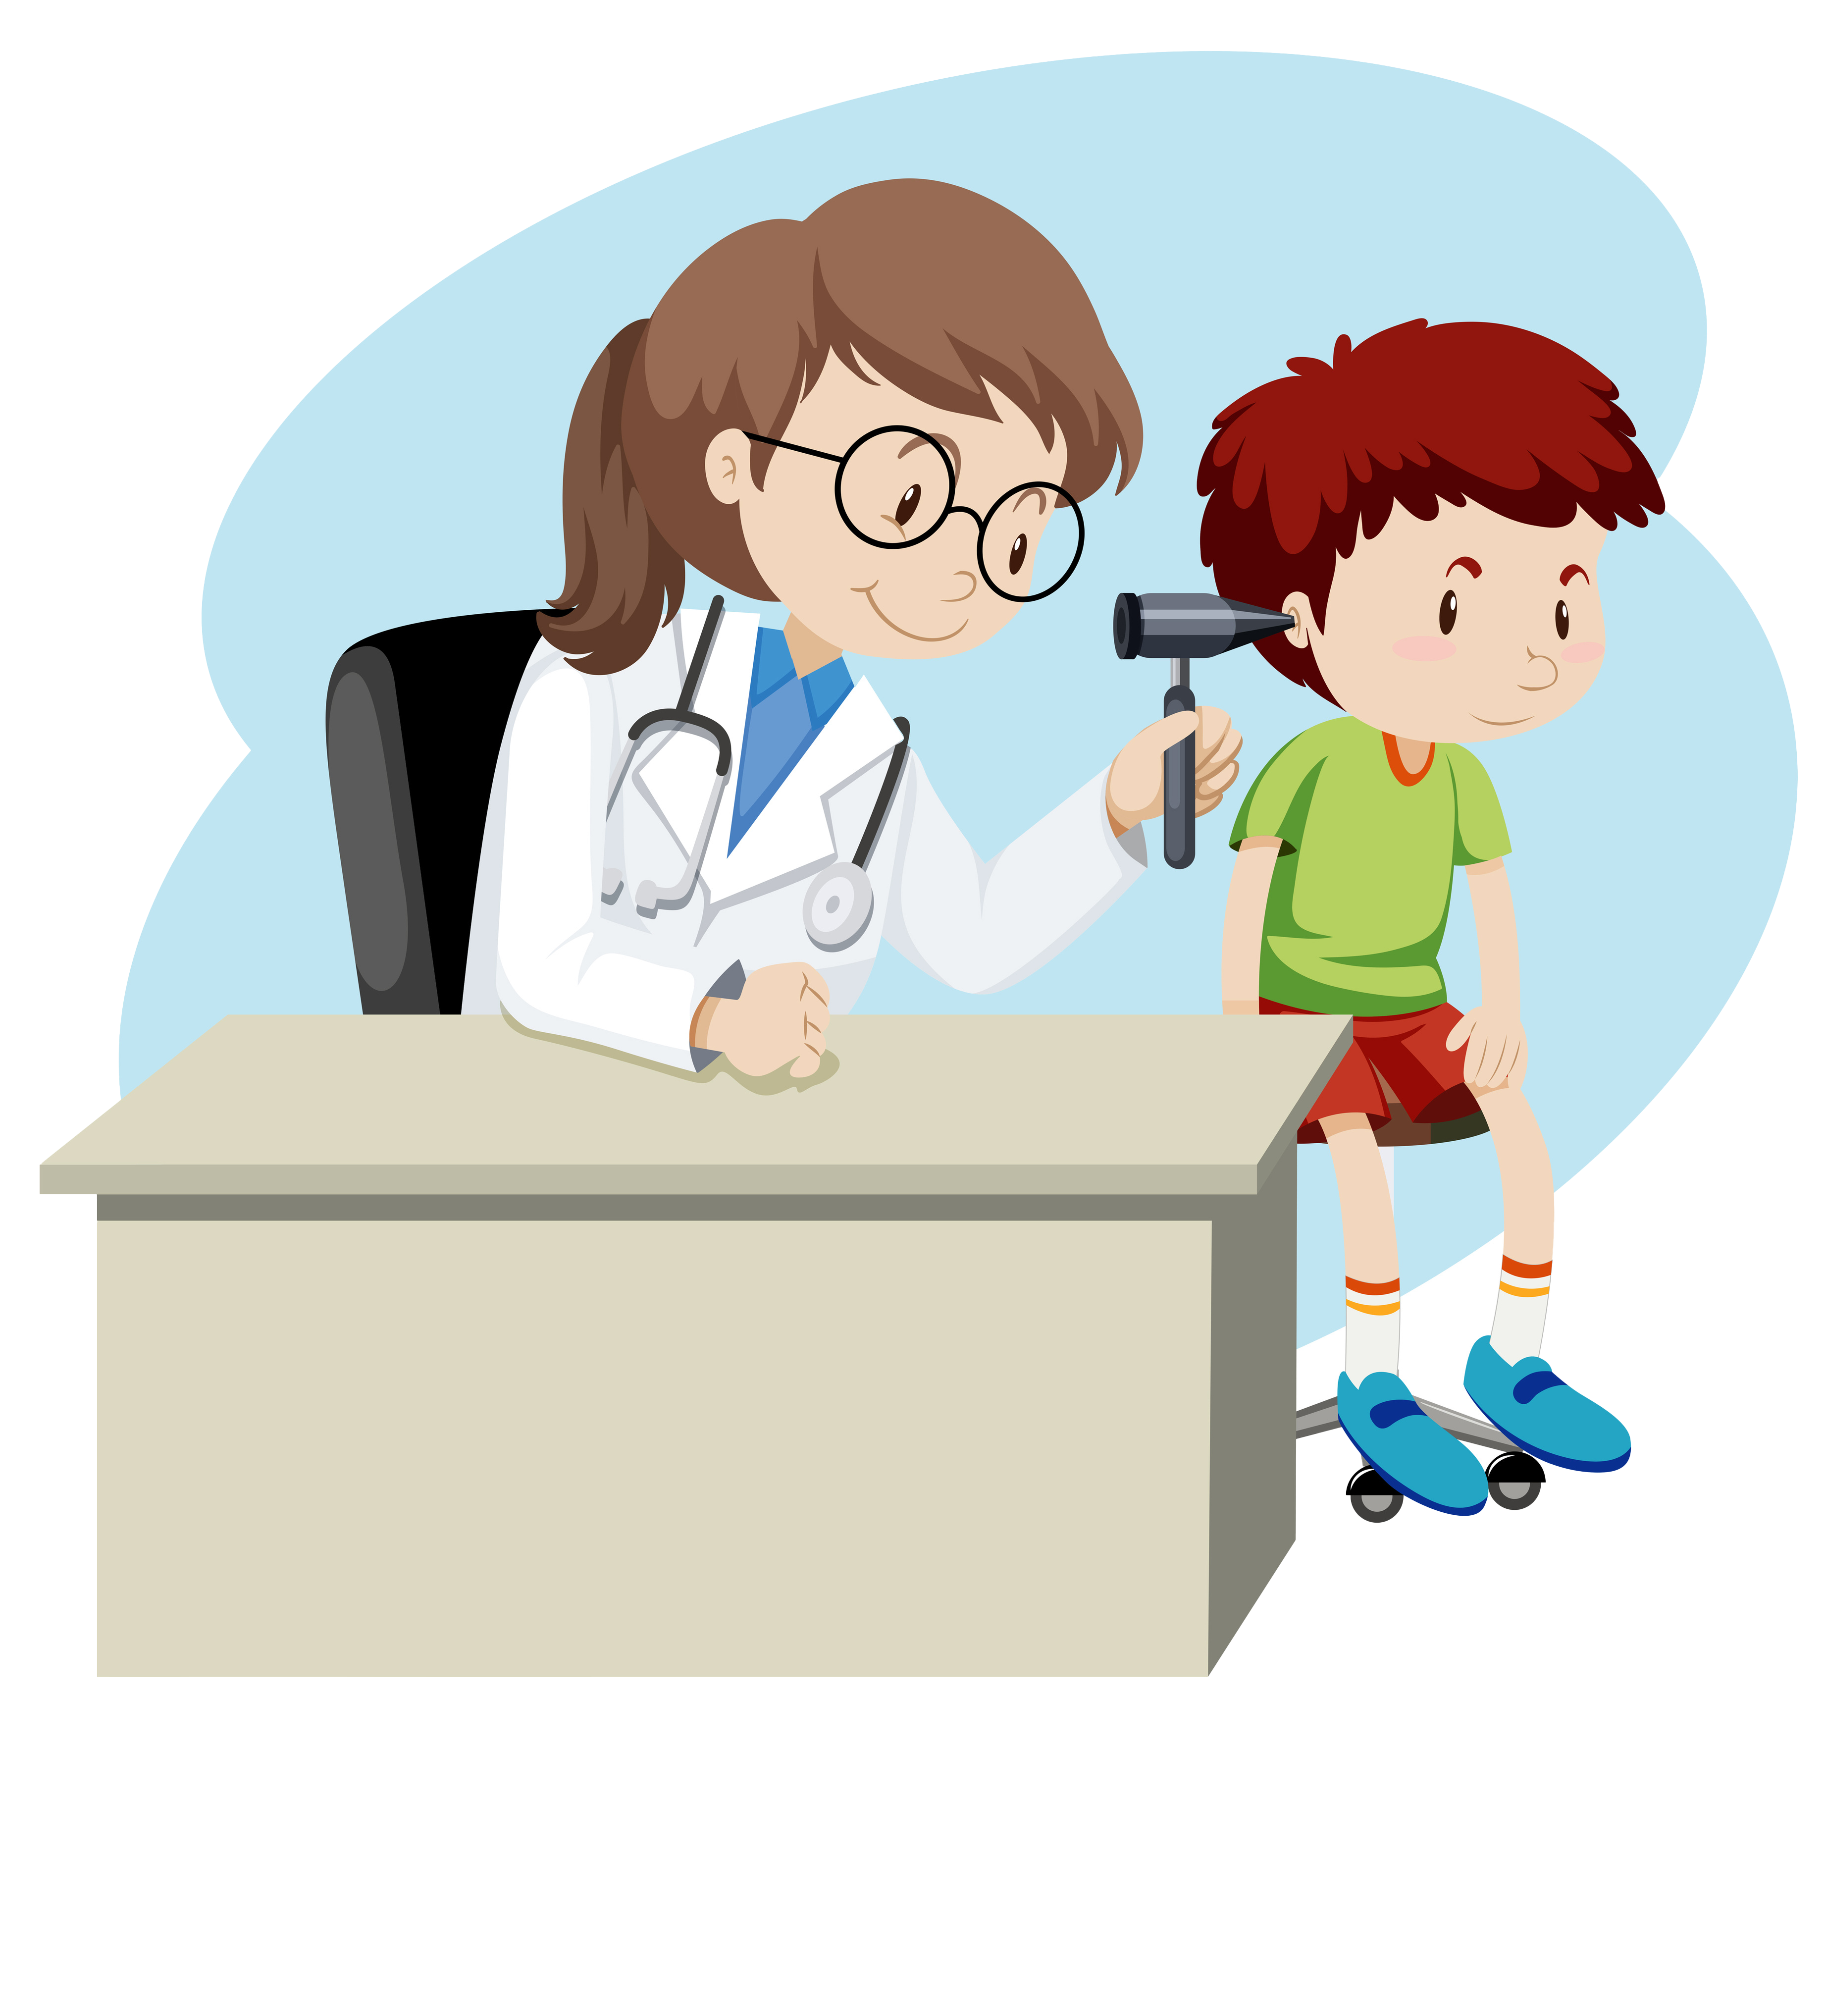
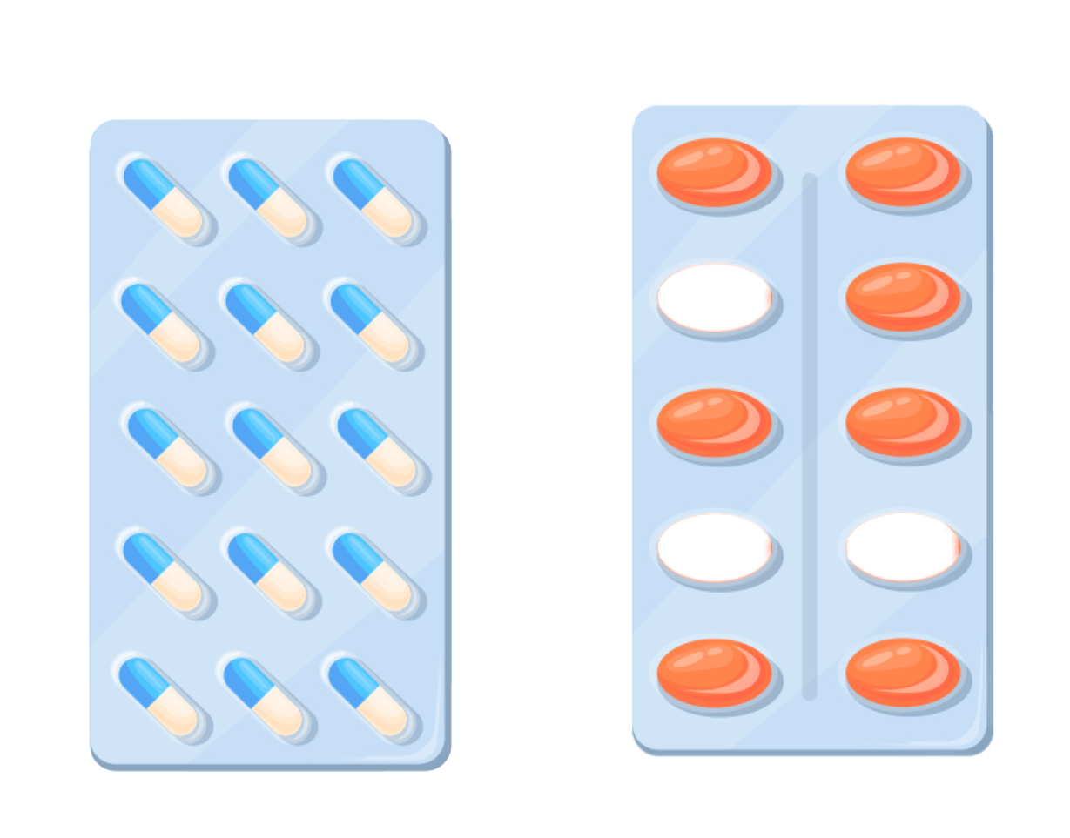
What is a PA?
PAs are educated health care providers who work on a team with a doctor to help patients when they are feeling sick or need a check-up!

Slide 3
What do PAs do?

Slide 4
PAs:
Perform check-ups
Prescribe medicine to help you feel better when you’re sick
Monitor patients in the hospital to make sure that they’re feeling well

Slide 5
PAs:
Test
to find out what's wrong when you’re not feeling well
Teach
your caregiver what to do to help you feel better and stay healthy
Learn
about when you haven’t been feeling well in the past

Slide 6
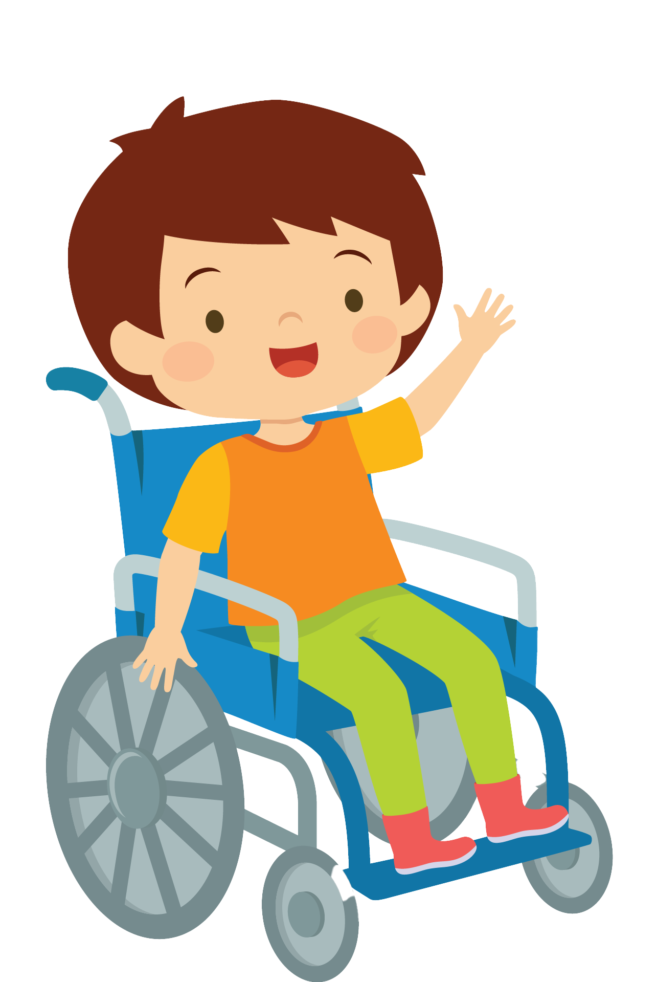
Where do PAs work?

Slide 7
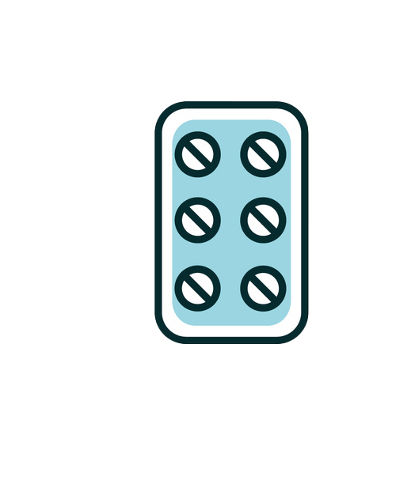
Where do PAs work?
PAs work everywhere that patients go to feel better, like:
Hospitals
Military
Urgent Care
Schools
Community Clinic

Slide 8
Can I be a PA?
Yes, you can!

Slide 9
How do I become a PA?
1
4
2
5
3
6
Pay attention in class, and listen to your teachers.
Graduate high school and college.
Get some experience working in health care and then go to PA school.
Study math and science.
Find ways to volunteer to help make your community healthier.
Graduate PA school, and then you’re on your way to being a PA!

Slide 10
What questions do you have about PAs?

Slide 11
THANKS!
Learn more about PAs and download resources at pasdothat.net/become-a-pa

