Slide 1
Physician Assistants/ Physician Associates (PAs): PArtners in Care

Slide 2
What is a PA?
Since 2021, the title of the profession includes ‘physician associate,’ but the role has remained the same.

Slide 3
A PA is a medical professional who works as part of a health care team, usually with physicians, nurses and other health professionals.

Slide 4
PAs are graduates of accredited PA programs and are nationally certified and state-licensed to practice medicine.

Slide 5
A Timeline of PA History
The Case for PAs
Demand for access to health care
Supply of former medical personnel from the military
1960s
Health services are delivered by private physicians and nurses.
Dr. Eugene A. Stead, Jr. announced plans to create a “physician assistant” program at Duke Hospital. The program would use former military corpsmen and be set up like the teamwork between a doctor and their assistant, which was a well-known medical team in rural North Carolina.
1965
Dr. Stead announces the nation’s first “physician assistant” educational program at Duke University. The program accepts four former Navy corpsmen.
Notes:
Health services are delivered by private physicians
Community based, solo practices
Self-pay and barter
Hospitals/acute care facilities
Severely ill or injured
Those needing surgery
Women delivering babies
1965
A Reader’s Digest article about jobs in the health care industry mentions the development of the PA program at Duke University causing a flood of inquiries from ex-military corpsmen.
A White House conference on health discusses the use of former military corpsmen/medics as assistant medical officers.

Slide 6
What can PAs do?
Perform minor surgeries
Assist in major surgeries
Prescribe medication
Diagnose and manage diseases, including chronic illnesses
Monitor and manage hospital inpatients

Slide 7
What can PAs do?
Perform physical exams
Educate patients on treatment and health maintenance
Order and interpret lab tests
Obtain medical histories

Slide 8
178,708
Who are Board Certified PAs?
Age | Percent
<30 | 17.8%
30-39 | 38.8%
40-49 | 23.1%
50-59 | 12.5%
60+ | 7.8%
Race | Percent
White | 79.9%
Black/African-American | 3.4%
Asian | 6.8%
Native Hawaiian/ Pacific Islander | 0.3%
American Indian or Alaskan Native | 0.4%
Other | 2.6%
Multi-race | 2.3%
Gender | Percent
Male | 28.8%
Female | 71.2%
Non-binary | <0.1%
PAs in the U.S.
**7.2% of PAs indicate they
are Hispanic.

Slide 9
40
69
$123,490
Who are Board Certified PAs?
Average number of hours worked by PAs in principal position
Average number of patients seen by PAs per week in the U.S.
Average salary of
PAs in the U.S.

Slide 10
About Board Certified PAs
178,700+ PAs at the end of 2023
Median salary for new graduate PAs: $105,000
Median salary for PAs with 6+ years of experience: $125,000
PAs are a young profession; the median age of PAs is 38
Notes:
The “other” category is what PAs select if they don’t choose one of the 69 available response options. The most frequent responses PAs write-in were Urgent Care, Interventional Radiology, Sleep Medicine, Trauma, Bariatric Surgery, Correctional Medicine, and Functional Medicine. But there were many more unique responses and combinations of specialties (i.e., writing in more than one).

Slide 11
The top six specialties in which PAs practice:
Surgical Subspecialties (18.7%)
Orthopedic (10.7%); Cardiothoracic Vascular (3.2%) and Neurosurgery (2.1%)
Family Medicine/General Practice (16.5%)
Emergency Medicine (10.8%)
Internal Medicine - Subspecialties (9.9%)
Cardiology (2.9%); Gastroenterology (1.7%) and Oncology (1.6%)
Dermatology (4.3%)
Internal Medicine – General practice (4%)
*Source: 2023 Statistical Profile of Board Certified PAs

Slide 12
Practice Specialties
Family Medicine/General Practice
Surgical Subspecialties
Orthopedic Surgery
Cardiothoracic and Vascular Surgery
Neurosurgery
Emergency Medicine
Internal Medicine
Cardiology
Gastroenterology
Oncology
Dermatology
Hospital Medicine
General Surgery
Psychiatry
Critical Care Medicine
PAs practice in every medical and surgical specialty.

Slide 13
Where do PAs practice?
Recently Certified PAs practice in every state.
Top 5 PA Practice Settings
Hospitals (52.5%)
Office-based private practice (27.7%)
Urgent Care (5%)
Community health center (3.9%)
Rural health clinic (2.1%)
Top 5 States Where PAs Practice
New York (9%)
California (8.6%)
Florida (7%)
Pennsylvania (6.4%)
Texas (5.9%)
Source: 2023 Statistical Profile of Recently Board Certified PAs

Slide 14
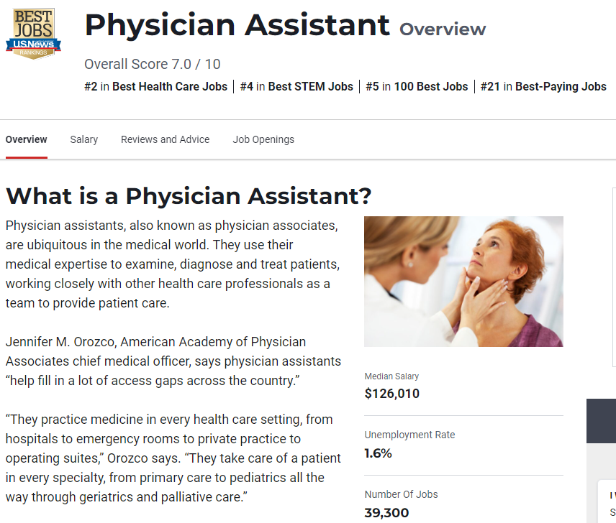
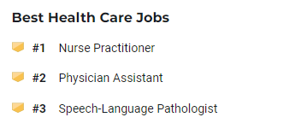
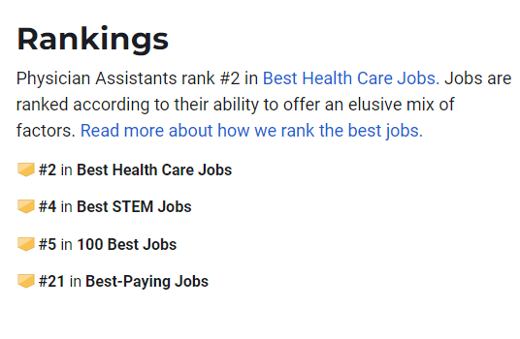
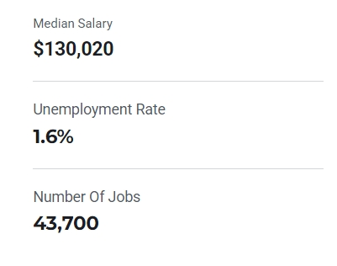
Board Certified PAs Rank Highly in Today’s Workforce

Slide 15
Steps to Become a PA
Research PA Programs
Bachelor’s Degree
Get HCE/PCE Experience
Understand the prerequisite courses you'll need to complete before applying to PA school.
After you obtain your bachelor's degree from an accredited college or university with a major in science, you may need to complete required courses for PA programs.
You'll need experience working in health care (HCE) or taking care of patients (PCE). You can look for HCE/PCE opportunities while you're still in college.

Slide 16
Steps to Become a PA
Apply to PA School
Complete PA School
Pass PANCE
Share your school transcripts, letters of recommendation and proof of your HCE/PCE experience. Most PA programs will want to interview you as part of the application process.
You’ll need to take and pass the Physician Assistant National Certifying Examination (PANCE) before you can get your license in your state. Once you pass, you can start applying for jobs and begin working as a Board Certified PA!
PA school lasts about 27 months.Before you graduate, you'll have to complete at least 2,000 hours of hands-on clinical training.

Slide 17
Job Satisfaction
Flexibility
We Need You
Job Outlook
Why Should You Become a Board Certified PA?
PAs are educated as generalists,
so they can change specialties throughout their careers. PAs generally enjoy a positive
work/life balance.
PA consistently ranks as one of the top jobs in health care.
As the population ages, more are expected to seek
health care services. Additional providers are needed to meet demand.
Employment of PAs is projected to grow 28% from 2023 to 2033, faster than the average
for all occupations.*
*Source: U.S. Bureau of Labor Statistics

Slide 18
178,708 Board Certified PAs have
answered the call.
Will you?
Consider becoming a PA.

Slide 19
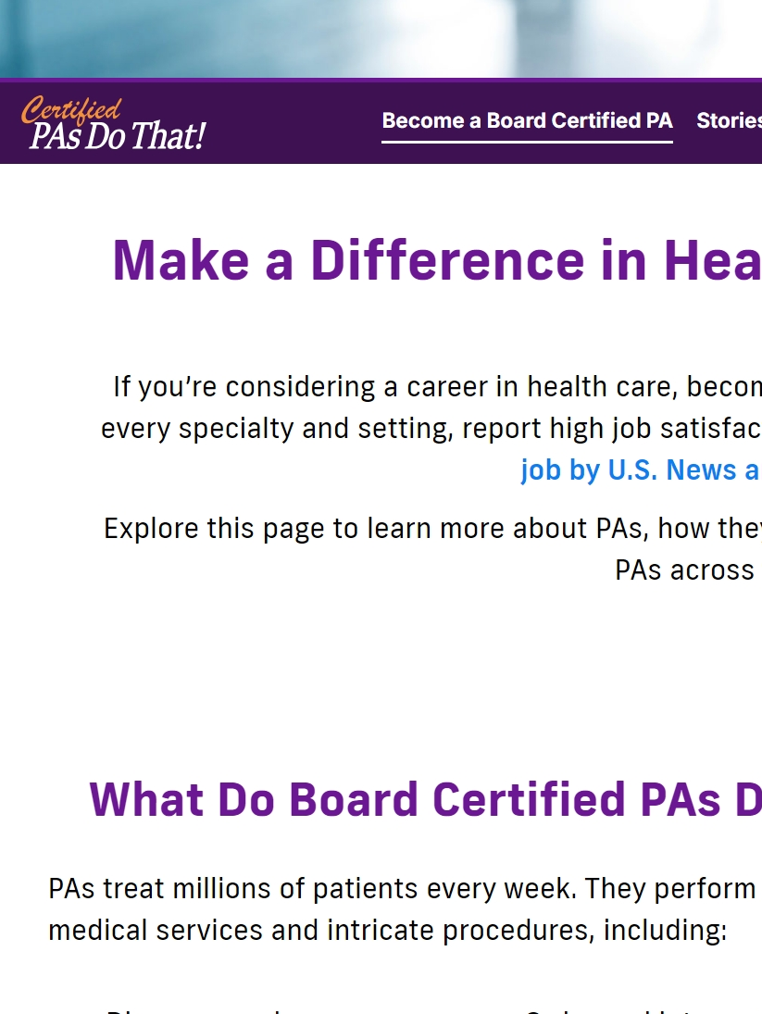
Learn More About the Profession!
PAsDoThat pasdothat.net
National Commission on Certification of Physician Assistants nccpa.net
American Academy of PAs aapa.org
PA History Society pahx.org

